Slide 1
Salt cavern development & capacity tool | UK onshore East Coast region
User manual
Version 1.0
February 2024

Slide 2
Contents
Tool Pages
Home/ Landing Page
Page 1. Multi-criteria Analysis
Page 2. Capacity Appraisal
Page 3. Development Programme
Page 4. Summary Report
Case Studies
Case Study 1 – Capacity in the Fordon Evaporite Formation
Case Study 2 – Capacity in the Boulby Halite & Fordon Evaporite Formation
Design Assumptions, Limitations & Opportunities
References

Slide 3
Tool Pages

Slide 4
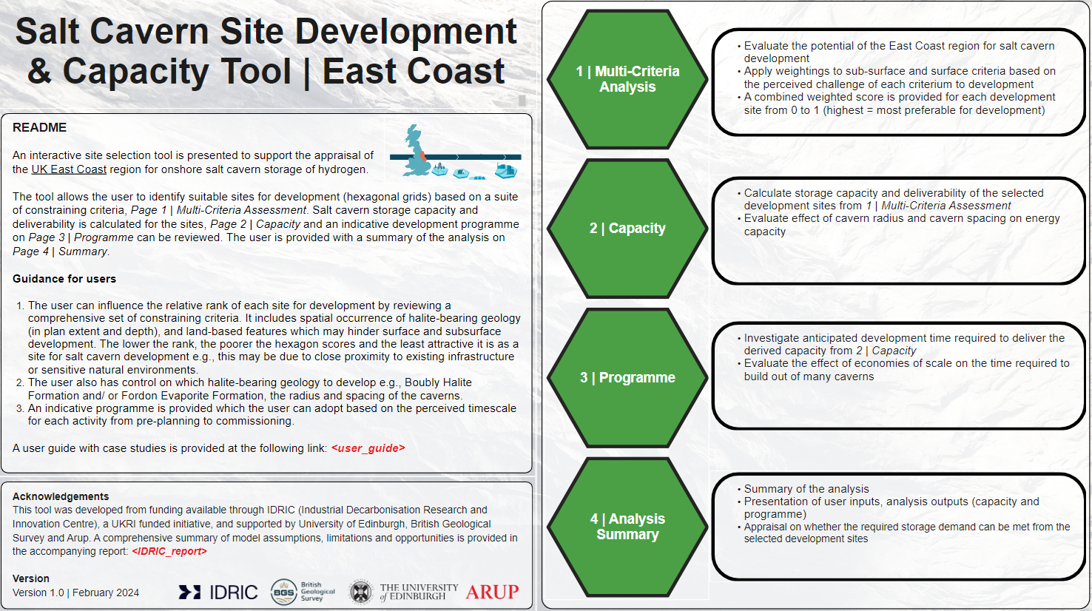
Home/ Landing Page
Click me to go to relevant page
Pages
Each page of the tool is described along with actions the user is expected to undertake and a link to each page is provided by clicking on the relevant green hexagon.
Page 1: Multi-Criteria Analysis. On this page the user will set weightings to each sub-surface and surface criteria. The effect of this is to exclude or evaluate each hexagon (development site) based on the impact of the criteria to any potential cavern development e.g., a salt cavern cannot be developed in the Fordon Evaporite Formation where Fordon thickness is 0 m, hence any hexagons where this is true will be eliminated. However if a hexagon is close (but does not intersect) with a Hydrogen Project, then the hexagon will be scored well.
Page 2: Capacity. On this page the user will firstly see the remaining hexagons from Page 1. The user will then define the geometrical and operational constraints for cavern development. The hexagons will be refined based on the feasibility to site caverns of selected radius in the given halite formations. and an estimate of energy capacity will be provided.
Page 3: Programme. An estimate of the programme timescale for cavern development is provided. Default values are provided based on industry knowledge and stakeholder engagement. The user can choose whether to model the time required to develop all the caverns as output from Page 2 Capacity, or override this number. Options also exist to define time-saving efficiencies based on optimal phasing of development activities and also due to construction of many caverns.
Page 4: Analysis summary. A summary page is provided which defines the user inputs, analysis outputs in terms of capacity and programme. The user has the option to define a “required storage capacity” which is compared against the analysis output. A maps of selected potential development sites is also provided.
README
This outlines the context and ambition of the tool, providing information on how it is envisaged to be used and by who.
Assumptions, limitation and opportunities associated with the development of the tool are provided in the associated, co-funded report “Assessing the Regional Demand for Geological Hydrogen Storage - Building a Strategic Case for Investment in the East Coast Cluster” (February 2024)
Acknowledgements
The development of the tool has been supported by several institutions provided here.
Version
The current version of the tool is provided in this section, along with relevant contact details.

Slide 5
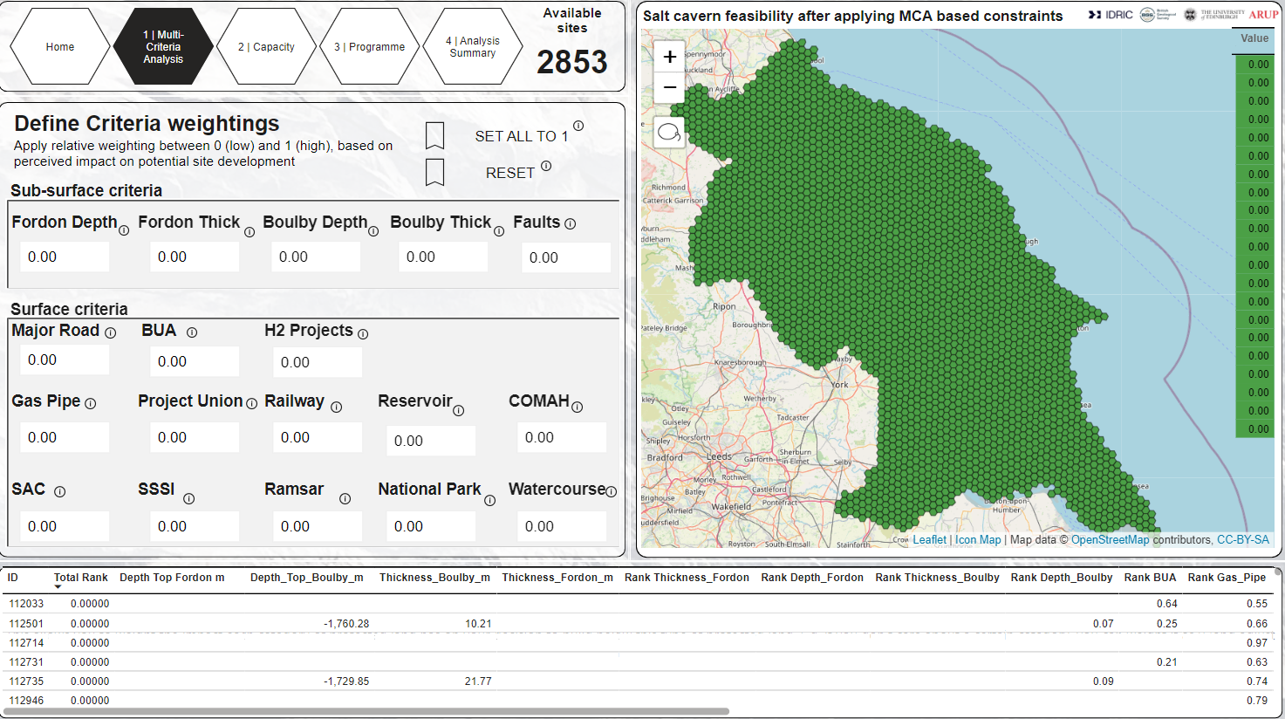
Page 1. Multi-Criteria Analysis
This title block presents the title of the tool WP2 MCA, Standing for Work Package 2 Multi-Criteria Analysis. It also provides interactive button which the user can click on to the right-hand side of the page, this includes links back to the landing page, WP2 scenarios, Capacity and programme tabs.
Additionally, the number of hexagons presented on the right-hand side of the page is presented here
Press on these buttons to automatically travel to other tabs
Number presents the number of hexagonal areas presented in right hand side figure
This number will change depending on the MCA applied
This view port of the tool presents the areas that are ‘feasible’ for salt cavern development based on your MCA criteria input on the left-hand side. This is a great visual aid for understanding the extent of feasibility based on your input.
Not only does this tool filter out non-feasible areas based on your input it will also rank the remaining hexagons from least favourable to most favourable. If you change the input criteria on your tool you will see that the value column on the right handside of this viewer portal will change, values will be ranked from 1.00 to 0.00.
The most favourable areas for development based on the input MCA being classed as 1.00 and coloured bright green and least favourable being ranked 0.00 and coloured white.
This section of the tool defines the MCA. It contains the parameters that will go into the Hydrogen capacity assessment. These parameters are defined below:
Depth to FEH – Depth to top of halite-bearing Fordon Evaporite Formation
Thickness of FEH – Thickness of halite-bearing Fordon Evaporite Formation
Reservoir – Water reservoir – opportunity to use for solution mining
H2 Projects – Existing and proposed hydrogen production projects
Depth to BHF - Depth to top of Boulby Halite Formation
Thickness of BHF - Thickness of halite-bearing Boulby Halite Formation
Major Road – Proximity to a major road – opportunity to utilise for construction works
Built-up Area – Proximity from built up areas (does not include rural communities)
Gas Pipelines – Proximity to gas pipeline infrastructure
Project Union – Proximity to proposed Project Union (national hydrogen delivery) infrastructure
Railway – Proximity to a railway line
Geological Faults – Proximity to major faults
COMAH – Proximity to site under Control of Major Accident Hazards (COMAH) regulations
SAC – Proximity to a Special Area of Conservation (SAC) site
SSSI – Proximity to a Site of Special Scientific Interest (SSSI)
Ramsar – Proximity to a wetland site of importance under the Ramsar Convention
National Park - Proximity to a National Park area
Watercourse – Proximity to a major watercourse
All off button – turns all parameter values to 1.00
Selection button for hexagons – draw a polygon around the area you want detailed information on
All on button – turns all parameter values to 0.00
You will notice that each parameter has an interactive box underneath, this box automatically contains a number. This number informs the weighting of that parameter in terms of the MCA.
In the case presented in this guide all numbers are presented as 0.00. The numbers in the box can be assigned from 0 to 1. 1 being the most important and 0 being the least important. This means that all the criteria have a ‘value of 0’, as a result there are no limitations on the salt cavern feasibility results, and no hexagons will be excluded from the analysis.
This is why the entire area with salt present in the northeast appears as green! This is an interactive function of the tool and allows the user to define which criteria they find most important / least important / irrelevant etc.
If you change the numbers in your toolbox, you will see how this impacts the presentation on the areas considered feasible for salt cavern development on the right-hand side section of the tool. Try to change the numbers and see what happens, the map shown on the right-hand side should become more restricted, and the colours of the hexagons will start to change. This reason for this will be discussed in the next section.
A summary table is present at the base of the page, this will present information on each of the hexagons that appear in the viewer. It includes the ranking of each hexagon (ID), for each criteria (e.g., Rank Thickness_Fordon) and also a combined rank (Total Rank) which describes the favourability (0 (low) to l (high)) based on the MCA input.
It will include a breakdown summary of the geology of each hexagon. The other MCA criteria will also have a ranking – this allows you to understand the favourability of each hexagon and where the overall ranking status comes from. This table also has an interactive function, by selecting hexagons from the right-hand side window you can pick out the areas that you want informed detail on in the table – rather than having all the hexagons which are present in the right-hand side viewer.

Slide 6
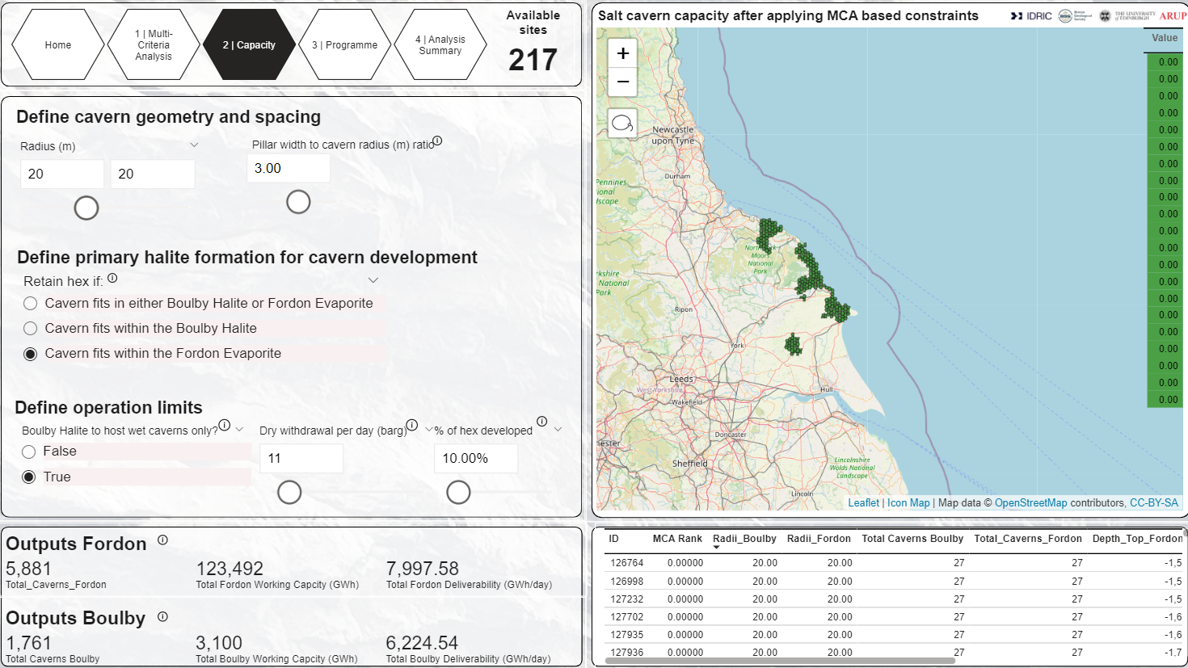
Page 2. Capacity Assessment
This title block is similar to that presented on the WP2 MCA page. The only notable differences between the two title blocks is the title and the number on the right-hand side of the block describes the number of hexagons that are relevant to the capacity assessment, which is based on the desired input radius for the cavern, cavern spacing and the with drawl rate. All of which are determined in the box below.
Page 2: Capacity. On this page the user will firstly see the remaining hexagons from Page 1. The user will then define the geometrical and operational constraints for cavern development. The hexagons will be refined based on the feasibility to site caverns of selected radius in the given halite formations. and an estimate of energy capacity will be provided.
This figure presents the remaining hexagons suitable for your salt cavern development through a combination of the MCA selected on the last page and the cavern design selected on this page.
These hexagons are interactive you can click and select them for more information.
If you click on a hexagon a pop up will appear, this pop up will show a summary of the cavern design trace including a breakdown of the radius and the depth of the cavern.
Once a hexagon is clicked the summary tables below present the detailed information, including the total no. of caverns, the working capacity and the deliverability of that hexagon.
This section defines the nature of the proposed cavern development including the cavern radius, the separation distance (as a function of cavern radius), the percentage of the hexagonal area that you want to develop and the withdrawal rate per day. This is important as only certain types of geologies will allow for the development of certain cavern sizes, spacing and pressure allowances (which influences with drawl rates). It also gives you the option to model the Boulby Halite Formation for wet or dry storage.
Change the cavern components to reflect what you consider the ideal cavern size, spacing , withdrawal rates and area size. You will see how the map on the righthand side changes – reflecting the areas that are suitable to your proposed cavern design!
This section of the tool presents the cavern capacity outputs based on the inputs from cavern design coupled with the MCA.
In this section the outputs from both the Fordon evaporite horizon and the Boulby halite Formation are presented. The number of caverns,
the total working capacity (GWh) and the total deliverability (GWh / day) are all presented. These are directly related to the inputs above, if you change your input, you will notice these values change. Additionally, you can click on specific hexagons on the righthand side image and a detailed output analysis for that specific hexagon will be produced in this tab.
This table presents a summary of the hexagons presented on the righthand side figure. It includes the radius of the proposed caverns within the Boulby halite and the Fordon Evaporite , total no. of caverns, a summary of the geology including depth and thickness of the Halite horizons. If you click on specific caverns in the figure above, the table will filter your selection and give a detailed analysis of those caverns only.

Slide 7
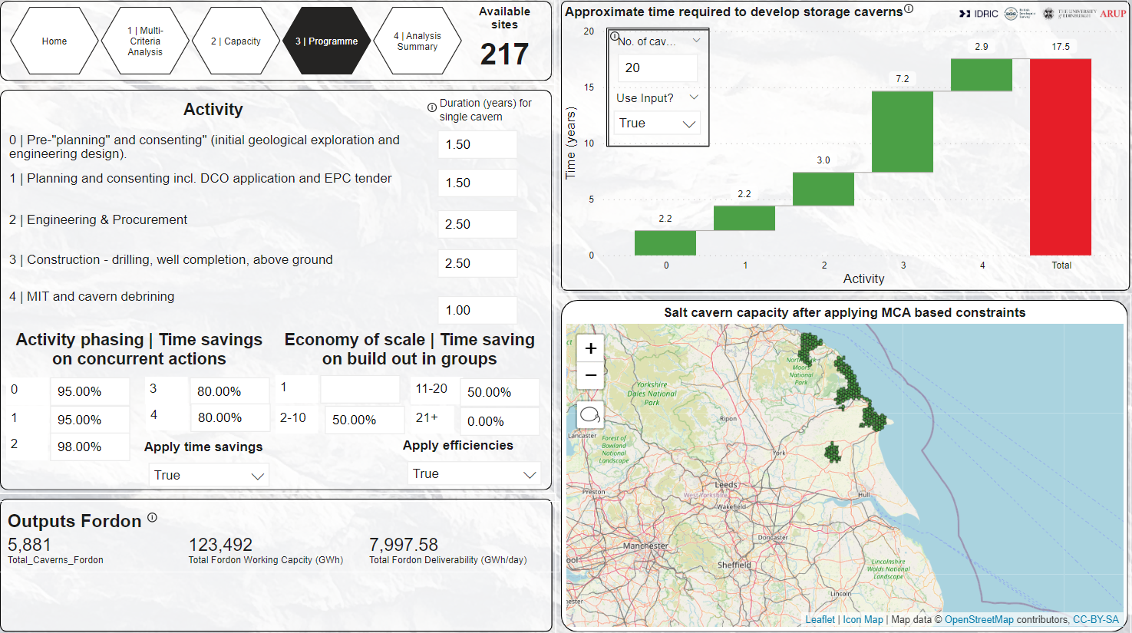
Page 3. Development Programme
Page 3: Programme. An estimate of the programme timescale for cavern development is provided. Default values are provided based on industry knowledge and stakeholder engagement. The user can choose whether to model the time required to develop all the caverns as output from Page 2 Capacity, or override this number. Options also exist to define time-saving efficiencies based on optimal phasing of development activities and also due to construction of many caverns.
This is a dynamic chart which provides the total required time for the development of salt caverns. The number of caverns used to derive this chart is either the total from the analysis, or it can be overridden by the user (e.g., to model the time required for developing a cavern cluster) by selected TRUE and providing the number of caverns to model.
Sources of information
The following sources have been used to derive recommended default values for the duration of activities and time-savings for the development of many caverns.
HyUnder, 2013. D(4) - Overview on all Known Underground Storage Technologies for Hydrogen.
Energy Technology Institute (ETI) & Foster-Wheeler, 2013. Hydrogen Turbines - Hydrogen Storage and Flexible Turbine Systems WP2 Report - Hydrogen Storage.
INEOS, 2014. The Keuper Gas Storage Project newsleter April 2014.
H21 , 2018. H21 North of England. H21 NoE Report/2018.
Hydrogen UK, 2022. Hydrogen Storage: Delivering on the UK's Energy Needs.
INEOS, 2024. Keuper Gas Storage Project Plans. Accessed February 2024. Available online: "https://www.kgsp.co.uk/the-plans/".
INEOS, 2024. Verbal communication with Richard Stevenson regarding HyKeuper project. 22 February 2024.
H2eart for Europe, 2024. The role of underground hydrogen storage in Europe.
Energy Technology Institute (ETI), 2018. Hydrogen Turbines Follow On – Salt Cavern Appraisal for Hydrogen and Gas Storage.
Hydrogen TCP-Task 42, 2023. Underground Hydrogen Storage: Technology Monitor Report. 153 pages including appendices.
Activities
An indicative programme is developed from the key activities outlined here. They represent five key stages of salt cavern development, from pre-planning through to commissioning.
Fields are provided for the duration of each activity to develop a single salt cavern. These can be modified by the user however defaults are provided to inform the user of industry guidance/ rule-of-thumb.
Pre-planning. This activity includes community engagement, engagement with stakeholders, initial site investigation and site selection and the development of a preliminary/ indicative engineering design.
Planning & Consenting. Includes activities associated with submission of Development Consent Order (DCO) and those associated with tendering for the proposed works.
Engineering & Procurement. This activity includes detailed engineering design and procurement. It is dependent upon the supply chain to deliver skills and resources including people, solution mining equipment and fabrication of topside infrastructure.
Construction. This activity includes well drilling, installation of casing, solution mining, discharging of brine, changeover of well from brine to hydrogen, construction of topside facilities including dehydrators, compressors.
MIT & Commissioning. This activity includes mechanical integrity testing (MIT) to ensure the cavern is gas tight, and commissioning of the storage cavern for operational use.
Outputs are carried forward from Page 2 Capacity
Time-savings on activities & cavern scale
The time required to develop many caverns compared to a single cavern is not linear i.e., time is saved largely through i) optimal development phasing, and ii) economies of scale. Both of these are captured in this section. Select TRUE to model the programme with the time-savings.
Time-savings on activities. Time is saved through optimal phasing of activities such as concurrent activities taking place. Most saving will be made during 2. Engineering design and procurement, 3. Construction, and 4. MIT and cavern debrining, e.g., if a development of 20 caverns is built out in phases of 5 caverns, resources can be deployed along the development chain as the first caverns approach commissioning.
Default values are provided to inform the user of industry guidance.
Economy of scale. Comparing against a linear increase in time for additional development of storage cavern, efficiencies in the development system for each subsuequent cavern can be made. Note that industry recommends that currently caverns are developed in clusters of no more than 20. This is largely due to supply chain bottlenecks hence the default values do not indicate any savings beyond 20 caverns built out as part of the same development.
Default values are provided to inform the user of industry guidance.

Slide 8
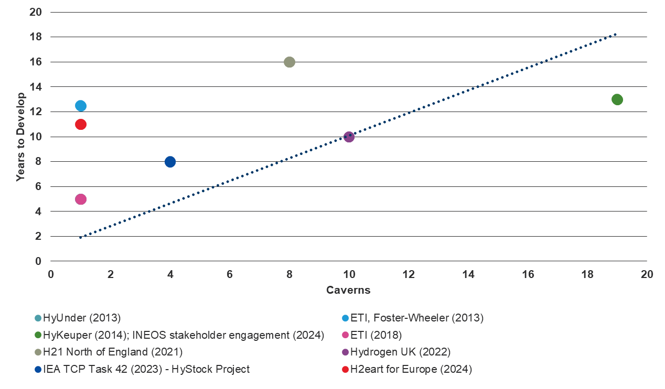
Cavern programme development
Indicative timescales from public sources
c.15 years for 20 caverns
c.9 years for 1 cavern

Slide 9
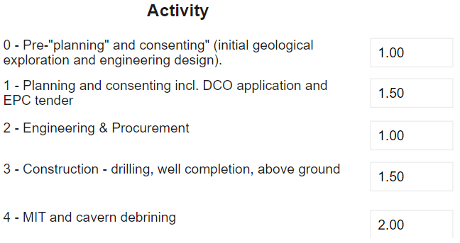
Programme Activities
1 cavern | 20 caverns
1.5 | 2.0
1.5 | 2.0
2.5 | 3.0
2.5 | 6.0
1.0 | 2.0
9 years | c.15 years
Time saving on each activity as already deployed skills and materials
Less applicable to Construction and Post-construction activities (#3 and #4)
Time saving from building out many groups of caverns simultaneously
Efficiencies up to a point, then will reach ceiling of supply chain
E.g., able to concurrently develop 2 groups of 10 caverns, but supply chain constraints limits any efficiencies beyond developing more than 20 for any single project site

Slide 10
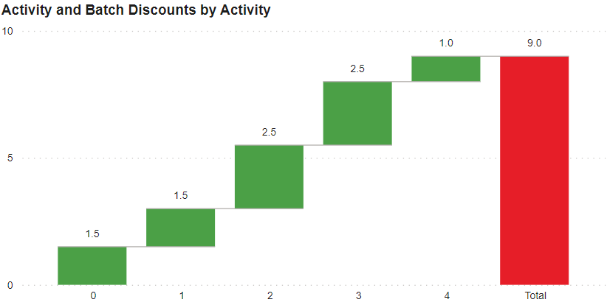
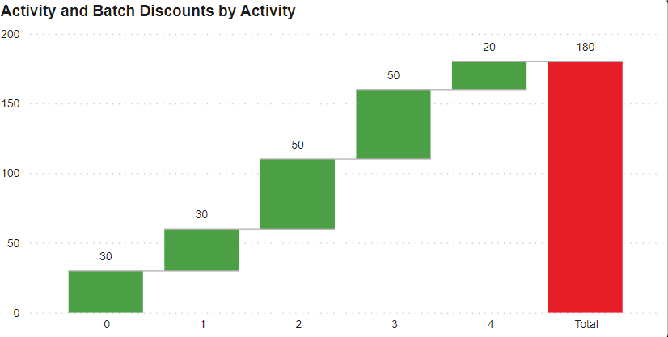
Programme Activities
1 cavern
Modelling time savings
Years
No time savings on activities or simultaneous cavern development
Activity
20 caverns

Slide 11
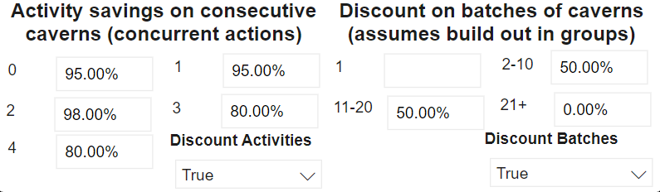
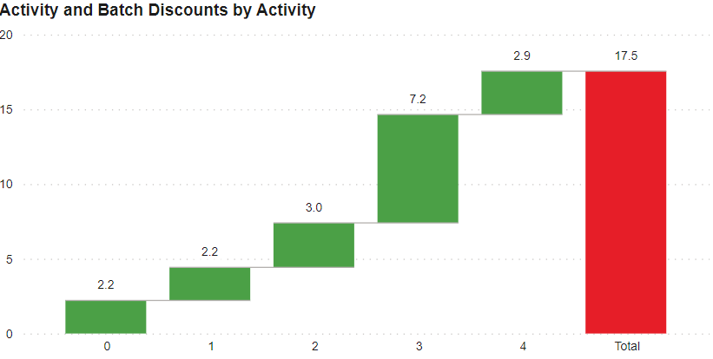
Programme Activities
1 cavern
Modelling time savings | Default Settings
1. Time saving on each activity for subsequent caverns as already deployed skills and materials
Efficiency from concurrent running of activities (phased cavern development).
Activities become more efficient for each additional cavern.
Years
Activity
2. Time saving from building out many groups of caverns simultaneously.
Optimised deployment of materials and skills for multiple cavern development.
Known limit of supply chain and brine disposal systems for a site greater than 20 caverns – no saving on additional caverns (0%).
20 caverns

Slide 12
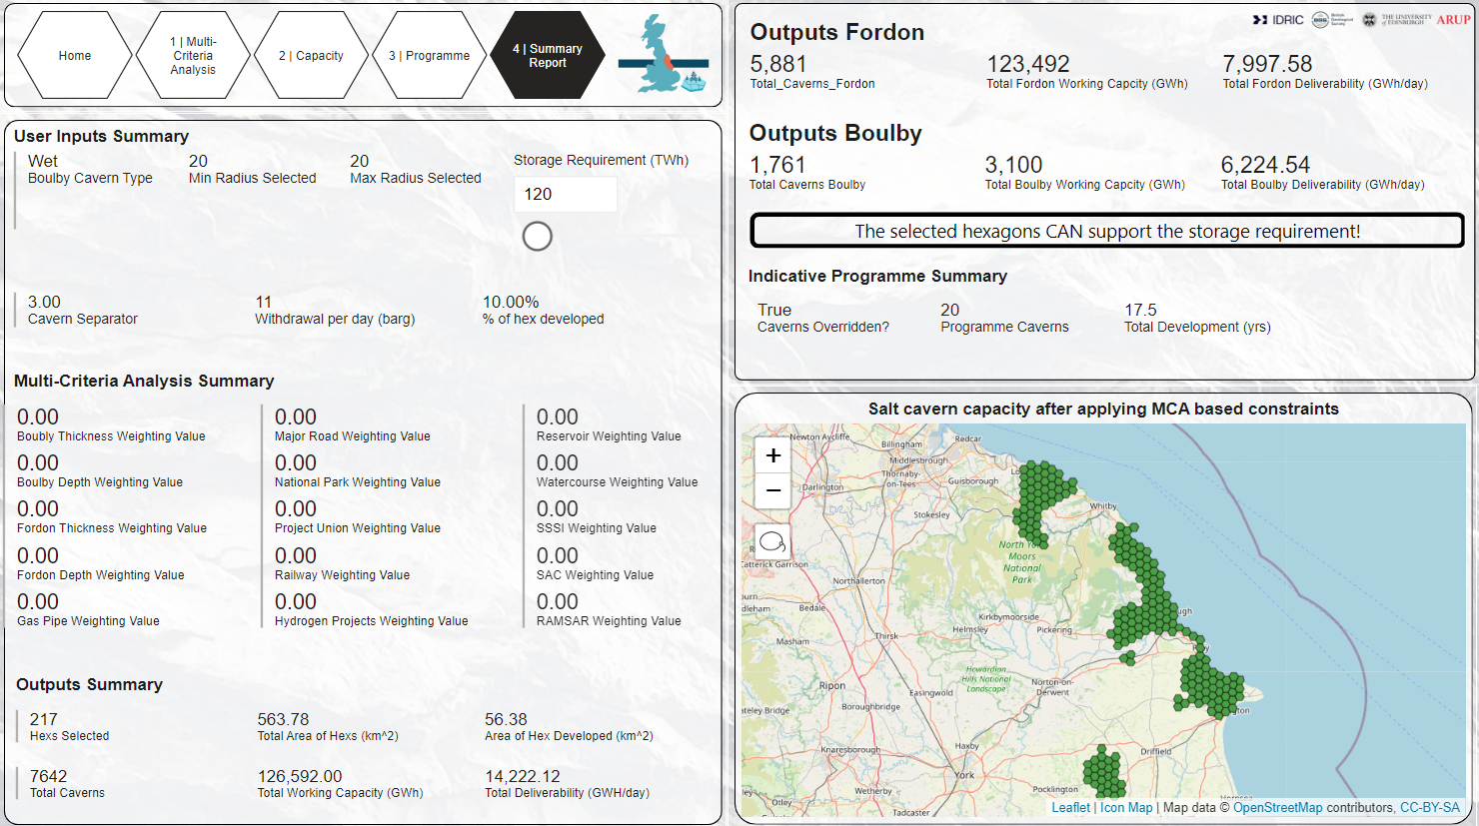
Page 4. Summary Report
A summary page is provided which defines the user inputs, analysis outputs in terms of capacity and programme. The user has the option to define a “required storage capacity” which is compared against the analysis output. A maps of selected potential development sites is also provided.
The user can choose to provide a storage capacity requirement here.
This is compared to the output of the analysis and a summary statement indicates whether the storage demand can be met through the user-defined scenario formed in Page 1 to Page 3.
A summary of the capacity and deliverability potential of the Fordon Evaporite and Boulby Halite formations is provided here.
User defined inputs from Page 1 Multi-Criteria Analysis and Page 2 Capacity (Cavern geometry and operational limits) are defined and provided here.
The output from the analysis is summarised, which includes number of caverns, total storage capacity, deliverability, programme estimate, development area.
A summary of the indicative development programme from Page 3 Programme is provided here.
Note that the number of caverns modelled for the programme may have been overwritten, so the programme timescale may not be specific to the total number of caverns derived from the analysis!
A summary of the selected hexagons for development is provided in this interactive map.
Note that the map is carried through from Page 2 and Page 3, so the initial hexagons available will be the same as seen on those pages.
The map is also interactive on this page, hence if a hex is selected, the Outputs Summary and Programme Summary (if number of caverns has not been overridden) will update accordingly.

Slide 13
Case Studies

Slide 14
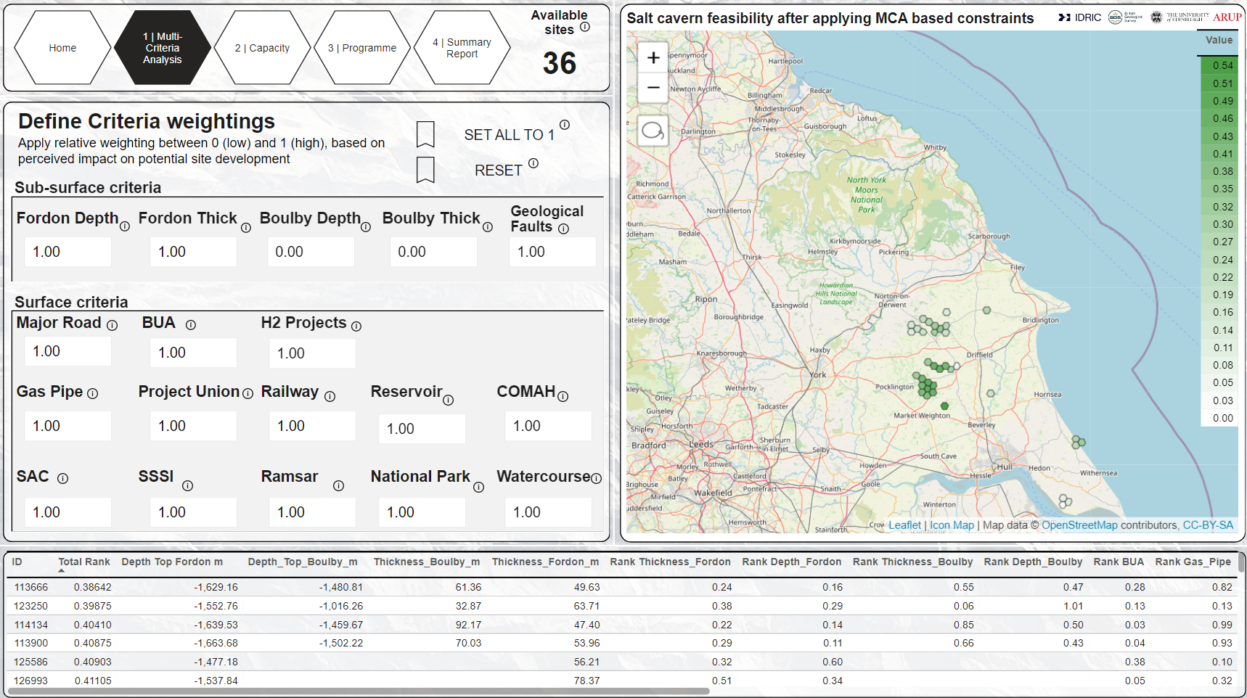
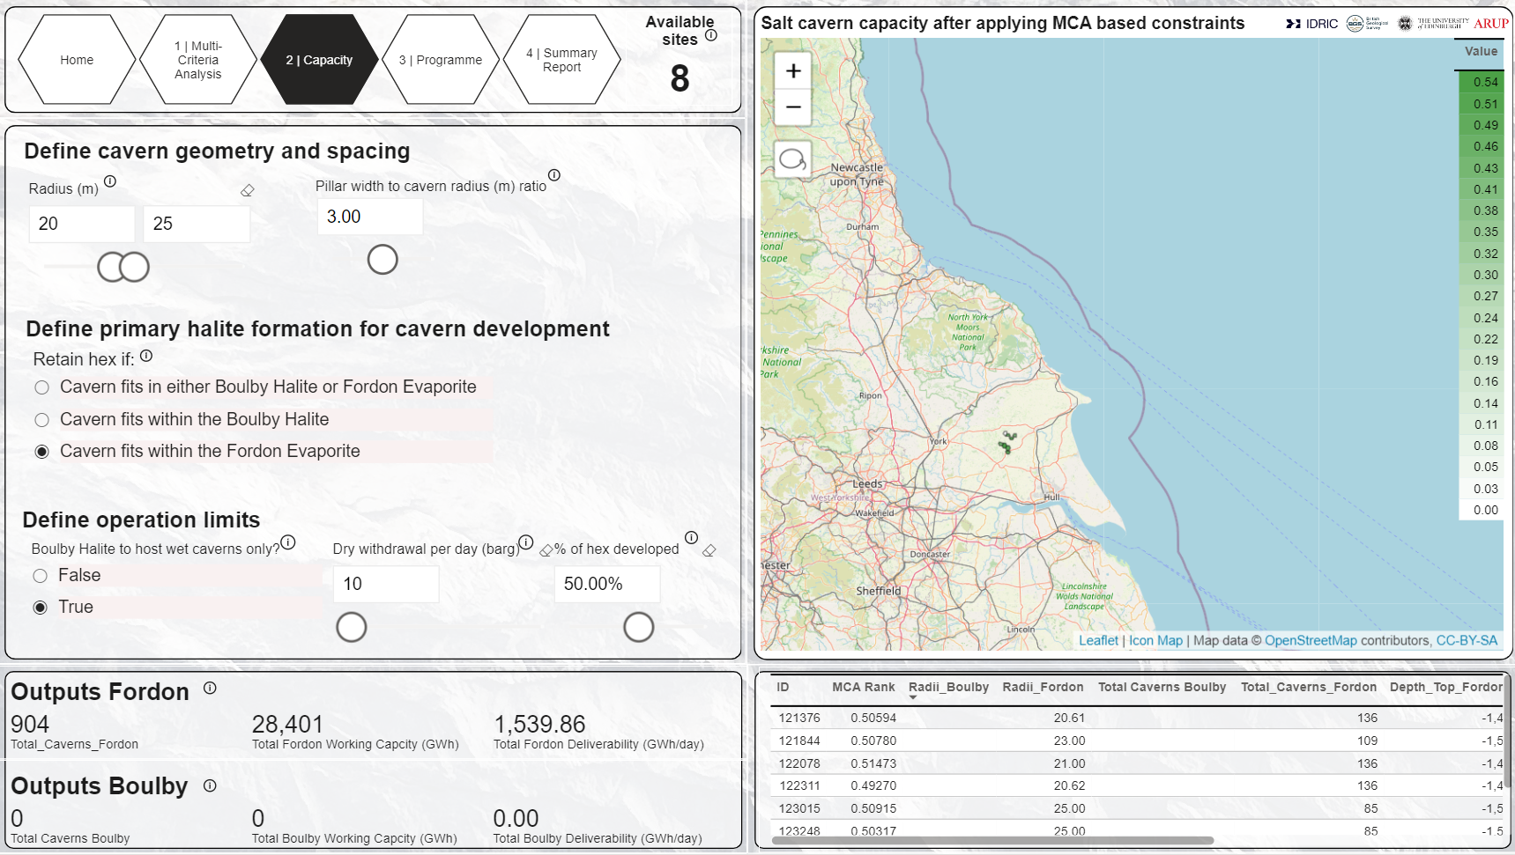
Case Study 1 – Capacity in the Fordon Evaporite Formation
1. Set relative criteria
2. Set design criteria
1
1
2
2
3
1. Fordon set to 1 will show sites where the Fordon Evaporite is present
2. Surface Criteria all equal to 1, therefore sites which interact with these criteria are excluded.
1. Cavern radius set between 20 and 25 m.
2. Only caverns within Fordon are modelled.
3.Only 50% of each site is developed for caverns.

Slide 15
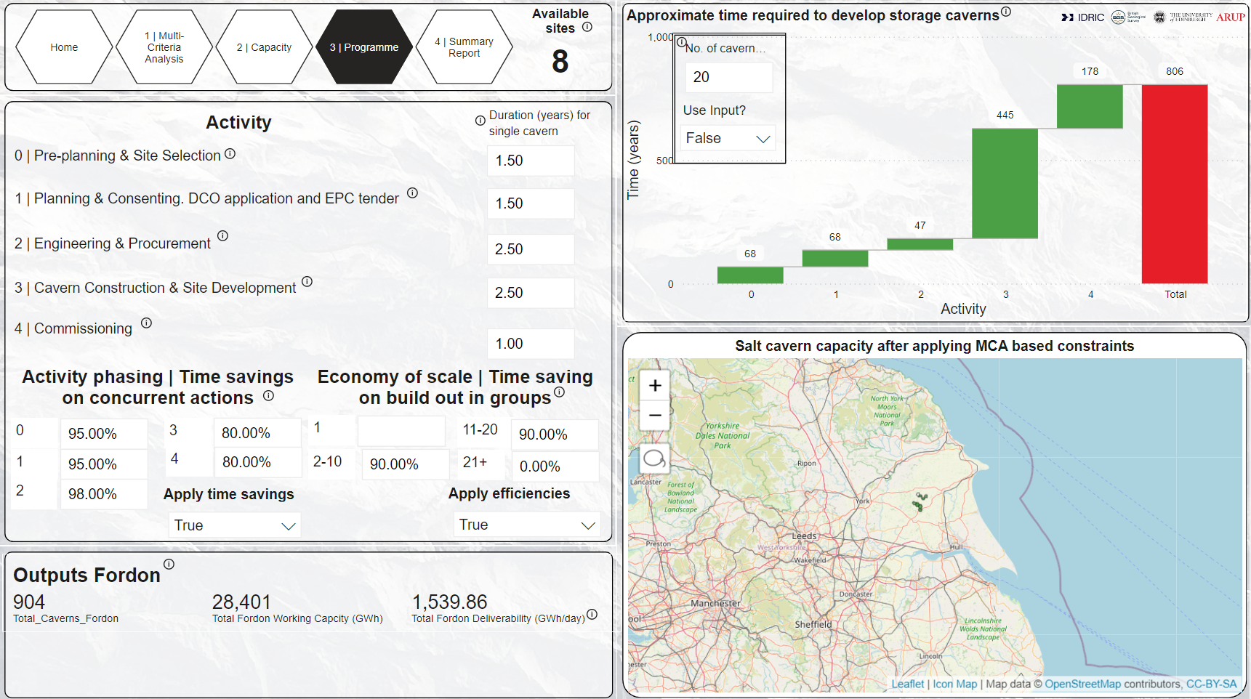
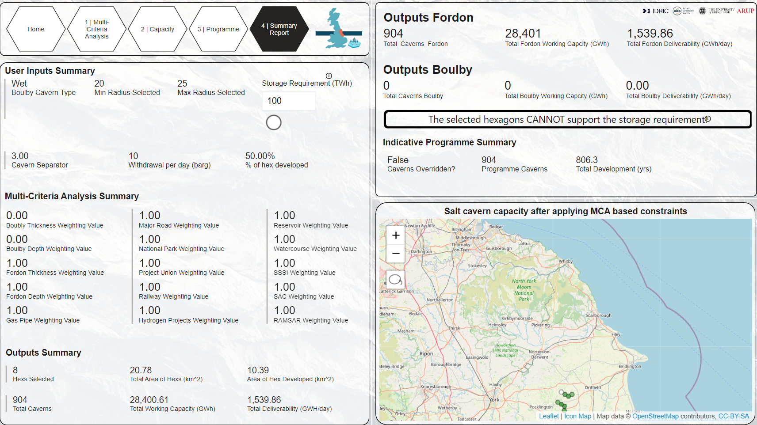
Case Study 1 – Capacity in the Fordon Evaporite Formation
3. Estimate development time
4. Summary
3
2
1
2
1
1. To use the data from your specific study i.e., as shown in “Outputs Fordon” (in this case 904 caverns)… 2. …set the time calculator to “False”
3. The total time required to develop 904 caverns is approximately 800 years. This is equivalent to around 45 sites of 20 caverns being developed concurrently, if each site takes 17.5 years to develop.
1. The storage requirement is set to 100 TWh
2. The requirement is compared to the capacity derived from your specific study. In this case the storage requirement CANNOT be met by storage caverns in the Fordon Evaporite Fm under the set conditions.

Slide 16
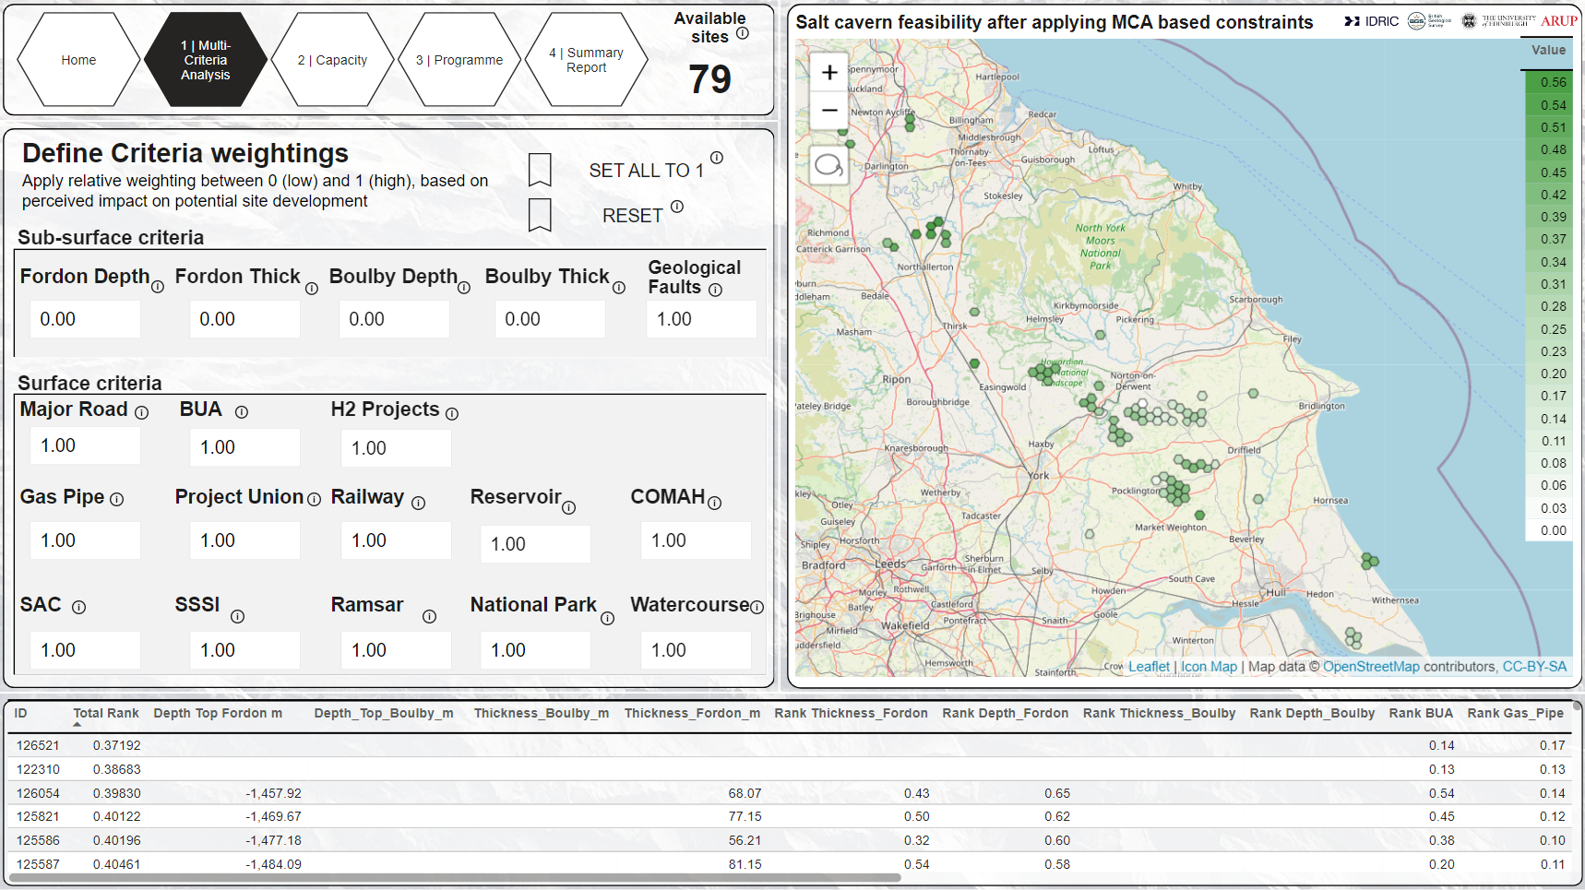
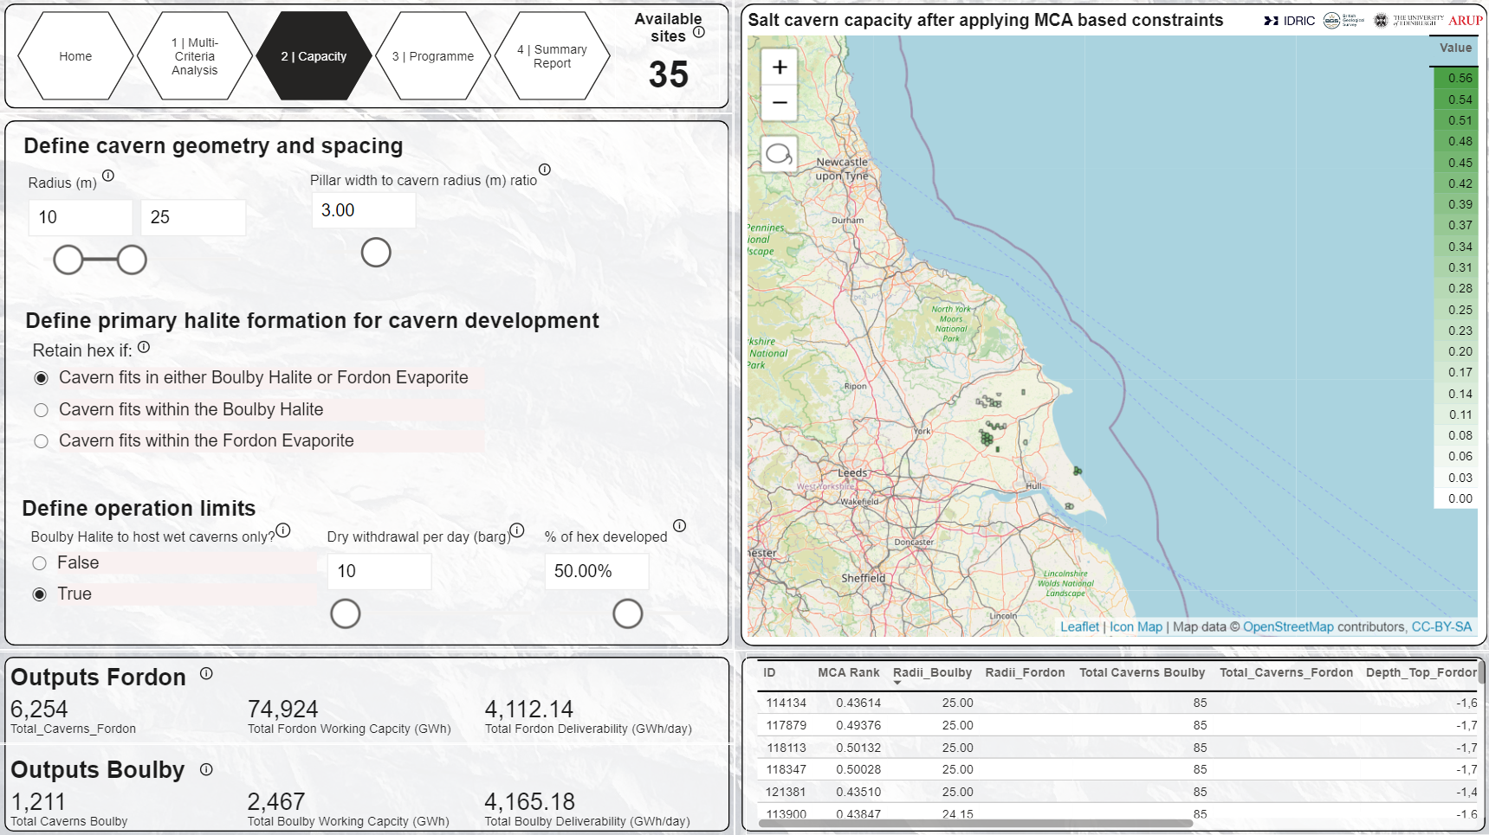
Case Study 2 – Capacity in the Boulby Halite & Fordon Evaporite Formation
1. Set relative criteria
2. Set design criteria
1
1
2
1. Fordon and Boulby properties are set to 0. The next page will identify sites which contain either Fordon or Boulby halite.
2. Surface Criteria all equal to 1, therefore sites which interact with these criteria are excluded.
1. Caverns in both Boulby and Fordon are modlled. This setting filters out sites which do not contain halite and leaves only those that do.

Slide 17
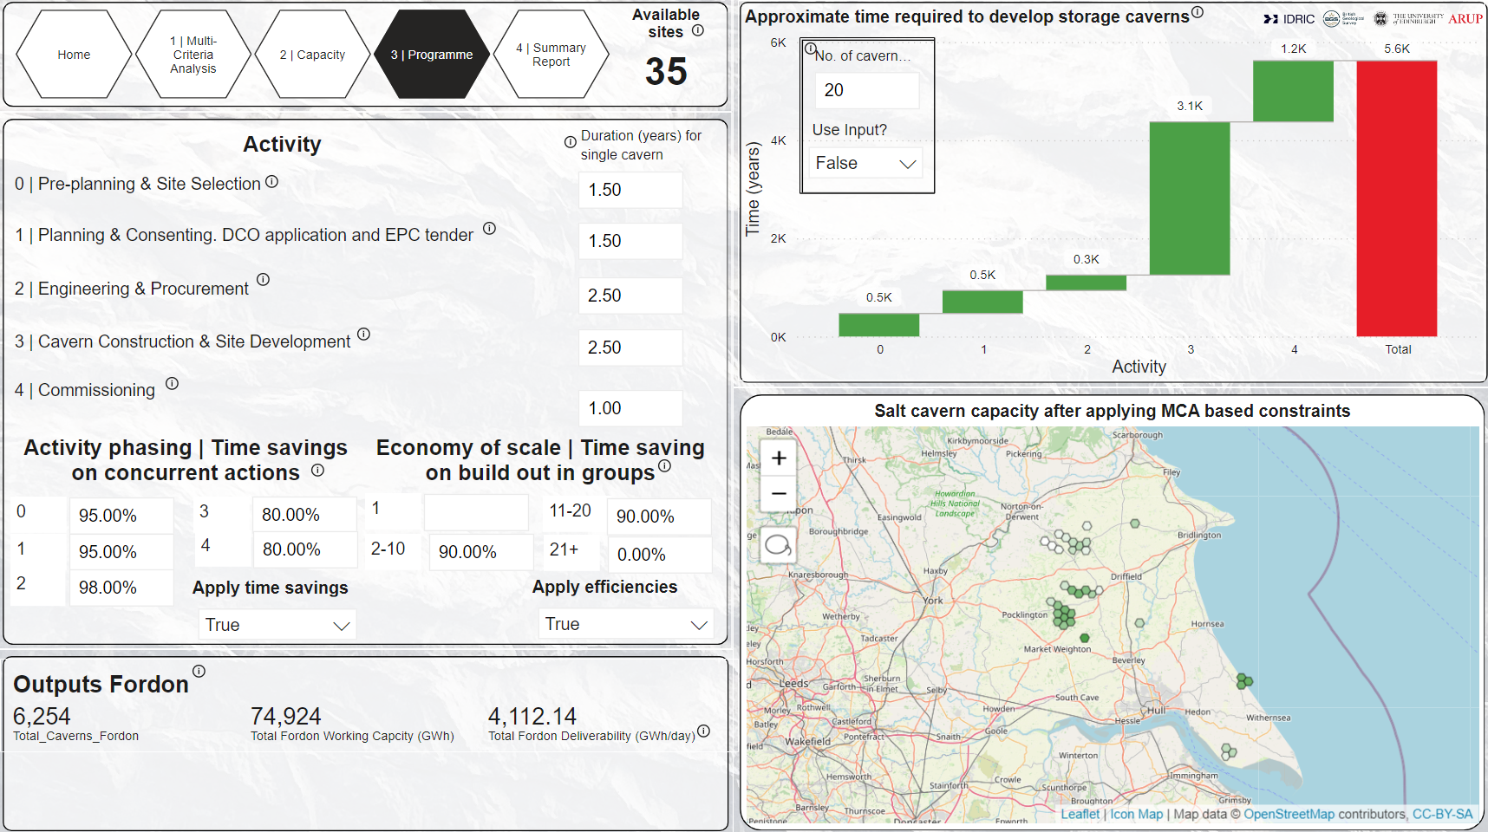
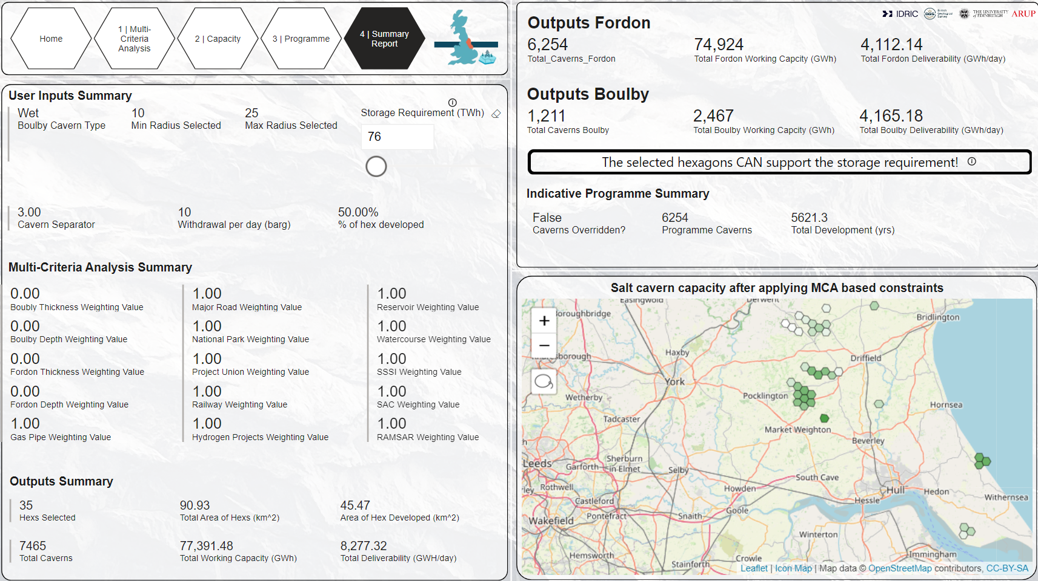
Case Study 2 – Capacity in the Boulby Halite & Fordon Evaporite Formation
3. Estimate development time
4. Summary
3
2
1
2
1
1. To use the data from your specific study i.e., as shown in “Outputs Fordon” (in this case 6254 caverns)… 2. …set the time calculator to “False”
3. The total time required to develop 6254 caverns is approximately 5600 years. This is equivalent to around 300 sites of 20 caverns being developed concurrently, if each site takes 17.5 years to develop.
Note that only development time of caverns in the Fordon are modelled.
1. The storage requirement is set to 76 TWh
2. The requirement is compared to the capacity derived from your specific study. In this case the storage capacity is 75 TWh + 2.5 TWh, from Fordon and Boulby respectively, totalling 77.5 TWh. Therefore, the requirement CAN be met!

Slide 18
Design Assumptions & Limitations
Extracts from co-funded report “Assessing the Regional Demand for Geological Hydrogen Storage - Building a Strategic Case for Investment in the East Coast Cluster” (February 2024)

Slide 19
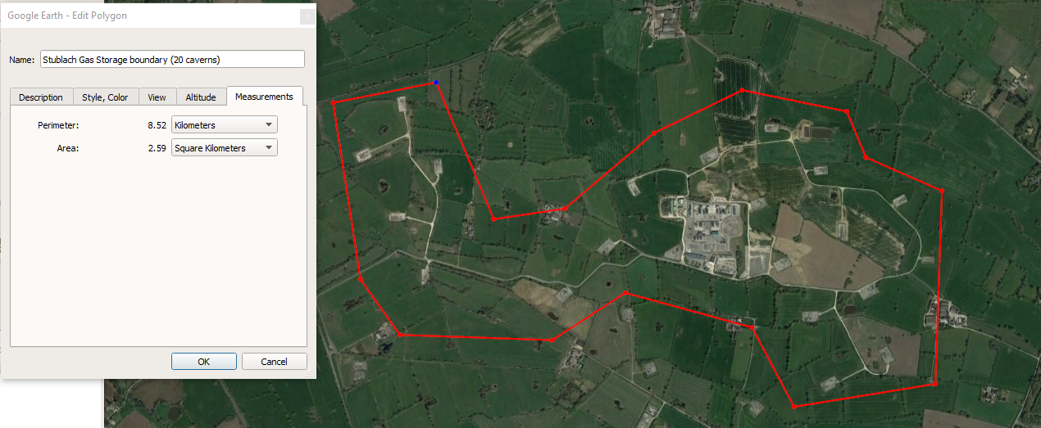
Sub-surface and Surface Constraints: Defining Exclusion and Evaluation Criteria
Relevance | Criteria | Allowable range
Sub-surface | Subsurface temperature | Below 80 degC. Excludes above 80degC. Based on geothermal gradient of 30degC/ km
Sub-surface | Depth to top of salt | Above 300 m. Closer to Goldilocks zone (600 m – 1200 m) the better.
Sub-surface | Salt thickness | Above 30 m
Sub-surface | Proximity to major fault | Above 200 m or 3 x cavern radius (whichever is greater). No grading.
Surface | Proximity to restricted development area (SSSI, SAC, RAMSAR, watercourses, National Parks) | Above 0 m from boundary. Further the better
Surface | Proximity to built-up areas | Above 2500 m or 3 x cavern radius (whichever is greater). Further the better.
Surface | Proximity to reservoirs | Above 200 m or 3 x cavern radius (whichever is greater). Closer the better.
Surface | Proximity to railways and major roads | Above 200 m or 3 x cavern radius (whichever is greater). Closer the better.
Surface | Proximity to major pipeline networks/ corridors including Project Union pipeline. | Above 200 m or 3 x cavern radius (whichever is greater). Closer the better.
Surface | Proximity to COMAH sites | Above 1000 m or 3 x cavern radius (whichever is greater). Further the better.
Surface | Proximity to offtakers | Closer the better
Appendix 2: Geological Hydrogen Storage Capacity Modelling for the East Coast Region
Development potential of sites across the East Coast region is evaluated based on a suite of defined criteria.
Relevance | Constraint | Allowable range/ criteria | Reference | Comment | Data sources
Sub-surface | Subsurface temperature | Below 80 degC. Excludes temperature above 80degC. Based on geothermal gradient of 30degC/ km | [11] | Exclusion criteria only | n/a
Sub-surface | Depth to top of salt | Above 300 m. Closer to Goldilocks zone (600 m – 1200 m) the better. | [12][13][14][15] | Exclusion & evaluation criteria | [43]
Sub-surface | Salt thickness | Above 30 m | Previous work considers a site if salt thickness is greater than 50 m (cavern height of 20m + roof and floor thickness of 30m) [2] | Exclusion & evaluation criteria | [43][7]
Sub-surface | Proximity to major fault | Above 200 m or 3 x cavern radius (whichever is greater). No grading. | [10][16] | Exclusion & evaluation criteria | [44][45]
Surface | Proximity to restricted development area (SSSI, SAC, RAMSAR, watercourses, National Parks) | Above 0 m from boundary. Further the better | Assumption based on [1] | Exclusion & evaluation criteria. Does not account for minor watercourses. | [46][48][49][50][51]
Surface | Proximity to built-up areas | Above 2500 m or 3 x cavern radius (whichever is greater). Further the better. | Assumption based on [1] | Exclusion & evaluation criteria | [58]
Surface | Proximity to reservoirs | Above 200 m or 3 x cavern radius (whichever is greater). Closer the better. | Assumption based on [13] | Exclusion & evaluation criteria | [52]
Surface | Proximity to railways and major roads | Above 200 m or 3 x cavern radius (whichever is greater). Closer the better. | Assumption based on [1][13] | Exclusion & evaluation criteria | [53][54]
Surface | Proximity to major pipeline networks/ corridors including Project Union pipeline. | Above 200 m or 3 x cavern radius (whichever is greater). Closer the better. | Assumption based on [1][13] | Exclusion & evaluation criteria | [47][55]
Surface | Proximity to COMAH sites | Above 1000 m or 3 x cavern radius (whichever is greater). Further the better. | Assumption | Exclusion & evaluation criteria. Does not represent site-specific COMAH requirements. | [57]
Surface | Proximity to planned hydrogen projects (i.e., offtakers) | Closer the better | Assumption | Evaluation criteria only | [59]
19 spatial datasets are considered in determining the storage capacity in the East Coast region (Table B2). The datasets comprise 6 sub-surface constraints and 13 surface constraints.
Sub-surface constraints are:
Depth and thickness of BHF and FEH
Geothermal gradient and temperature at depth
Major faults
Surface constraints are:
Proximity to restricted development area (SSSI, SAC, RAMSAR, watercourses, National Parks)
Proximity to built-up areas
Proximity to reservoirs
Proximity to railways and major roads
Proximity to major pipeline networks/ corridors including Project Union pipeline.
Proximity to COMAH sites
Proximity to current and potential offtakers
Each constraint is appraised on its impact on the development potential of a site. Sites are typically excluded where they do not meet the criteria e.g., directly intersect the constraint or lie outside of the allowable range. Sites which have not been excluded are evaluated on the criteria of a sub-surface or surface constraint such as, the further from a built-up area the better, and they are ranked accordingly, so the further a site is from a built-up area, the higher the rank.
Table B2. Sub-surface and surface evaluation and exclusion criteria

Slide 20
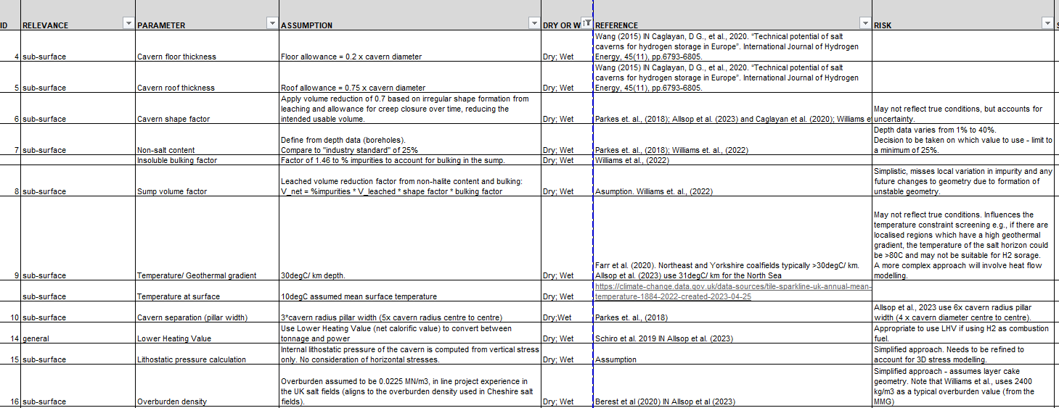
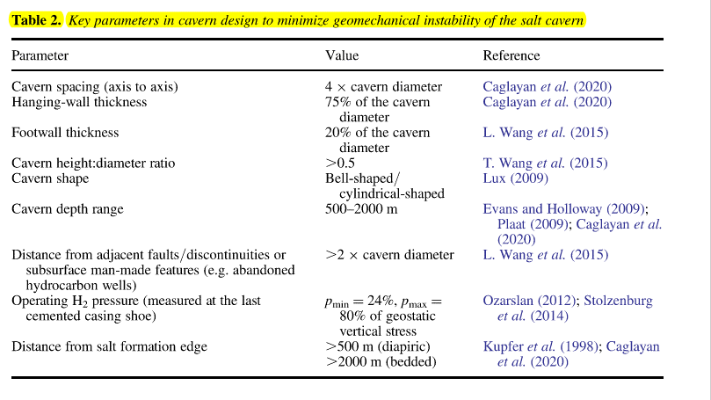
Design Assumptions: Dry and Wet Caverns
Appendix 2: Geological Hydrogen Storage Capacity Modelling for the East Coast Region
Key design assumptions in cavern design to minimise geomechanical instability of the salt cavern and adequately evaluate net cavern volume potential.
Relevance | Parameter | Assumption | Reference
Sub-surface | Cavern floor thickness | Floor allowance = 0.2 x cavern diameter | [1][10]
Sub-surface | Cavern roof thickness | Roof allowance = 0.75 x cavern diameter | [1][10]
Sub-surface | Cavern shape factor | Apply volume reduction of 0.7 based on irregular shape formation from leaching and allowance for creep closure over time, reducing the intended usable volume. | [1][2][9][17]
Sub-surface | Non-salt content | “Industry standard" of 25% | [2][17]
Sub-surface | Insoluble bulking factor | Factor of 1.46 to on the percentage of insolubles to account for bulking in the sump. | [2]
Sub-surface | Sump volume factor | Leached volume reduction factor from non-halite content and bulking: V_net = %impurities * V_leached * shape factor * bulking factor | Assumption based on [2]
Sub-surface | Temperature/ Geothermal gradient | 30degC/ km depth. | [18][9]
Sub-surface | Temperature at surface | 10degC assumed mean surface temperature | Assumption
Sub-surface | Cavern separation (pillar width) | Pillar width: 3*cavern radius (5x cavern radius centre to centre) | [17]
General | Lower Heating Value | Use Lower Heating Value (net calorific value) to convert between tonnage and power. | [9][19]
Sub-surface | Lithostatic pressure calculation | Internal lithostatic pressure of the cavern is computed from vertical stress only. No consideration of horizontal stresses. | Assumption
Sub-surface | Overburden density | Overburden assumed to be 0.0225 MN/m3, in line project experience in the UK salt fields (aligns to the overburden density used in Cheshire salt fields). | [9][20]
Allsop (2023)
Table B3. Design assumption relevant for storage capacity calculations in dry and wet caverns in East Coast region

Slide 21
Design Assumptions: Dry Cavern Specific
Appendix 2: Geological Hydrogen Storage Capacity Modelling for the East Coast Region
Key design assumptions in cavern design of dry operated caverns to minimise geomechanical instability of the salt cavern.
Relevance | Parameter | Assumption | Reference
Sub-surface | Cavern height | Cavern is modelled as a flat-topped cylinder. Max cavern height is calculated by salt thickness - roof thickness - floor thickness. Max ratio with diameter = 2D:H | [17]
Sub-surface | Cavern operation | Capacity calculations will allow for dry caverns to be modelling in the Boulby Halite Formation and Fordon Evaporite Formation. This study only models capacity in the Fordon Evaporite Formation from dry caverns. | n/a
Sub-surface | Cavern radius | Cavern is modelled as a flat topped cylinder. Max cavern height is calculated by salt thickness - roof thickness - floor thickness. Max ratio height with diameter = 2D:H Minimum radius set at 5 m. Therefore minimum salt thickness required for caverns to be constructed: (cavern height = 20 m + roof thickness + floor thickness = 10 m) = 30 m. | [1][10][17][21]
Sub-surface | Operating pressure limits | Pmin set at 24% lithostatic. Pmax set at 80% lithostatic. | [1] (Note that [22] assumes Pmin = 0.2 x lithostatic)
Table B4. Design assumption specific to dry cavern storage, relevant for storage capacity calculations

Slide 22
Design Assumptions: Wet Cavern Specific
Appendix 2: Geological Hydrogen Storage Capacity Modelling for the East Coast Region
Key design assumptions in cavern design of wet operated (brine-compensated) caverns to minimise geomechanical instability of the salt cavern.
Relevance | Parameter | Assumption | Reference
Sub-surface | Cavern height | Cavern is modelled as a spinning top. Max cavern height is calculated by salt thickness - roof thickness - floor thickness. Max ratio with diameter = H:0.5D | [23]
Sub-surface | Cavern operation | Wet operated caverns will only be applied to Boulby Halite Formation (BHF). The site selection tool allows the user to choose to model caverns in Boulby (BHF) as either wet or dry operated caverns. | [23]
Sub-surface | Cavern radius | Cavern is modelled as a spinning top. Max cavern height = salt thickness - roof thickness - floor thickness. Diameter at widest point is approximately twice the length of cavern height (2D:H) [23]. This is to maximise storage volume given the thin halite bed. Minimum cavern radius is set at 10 m, therefore caverns can only be sited in salt equal to or greater than 30 m thick (cavern height = 10 m; roof allowance = 15 m; floor allowance = 5 m). | [23]
Sub-surface | Operating pressure limits | Constant internal pressure at halmostatic pressure (full-head of brine). Brine assumed to have unit weight of 0.0118 MN/m3. | [23]
Table B5. Design assumption specific to wet cavern storage, relevant for storage capacity calculations

Slide 23
Limitations & Opportunities
Appendix 2: Geological Hydrogen Storage Capacity Modelling for the East Coast Region
To enable further development of the research presented in this work package, key limitations are presented. Additionally, there exists many opportunities to further refine the theoretical storage capacity in salt caverns towards a “realisable potential”.
Limitations
Development sites are predefined on a 2.5 km² hexagonal footprint. The area is considered to be appropriate and similar to other development sites in the UK, such as Keuper Gas Storage Project. If a hexagon intersects with any surface constraint, the entire hexagon will be removed from the analysis. A smaller hexagonal grid size could be considered to better optimise the available land for development.
The geological model has been informed from publicly available dataset from UK Onshore Geophysical Library (UKOGL) and onshore mapping published by British Geological Survey (BGS). Additional datasets such as seismic sections and intrusive data should be considered at any future stage.
For the scope of this study, a region-wide appraisal, the granularity of the ground data used to develop the geological model is considered to be appropriate. It is worth noting that as the input data is generally at a much lower resolution than the size of a hexagon, significant geological uncertainty exists for each hexagon.
Site-specific geological models should be developed to assist more rigorous development opportunities on a local basis.
Ultimately, this is a regional study and all assumptions should be tested and refined on a site-specific basis with site-specific data.
Opportunities
Refine geological model. Incorporate additional ground data such as BGS GeoIndex boreholes and geophysics sections to better constrain the extent, depth and thickness of salt horizons.
Refine workable volume insoluble content. A uniform value of 25% of non-halite geology is considered for the workable volume of Boulby Halite Formation and Fordon Evaporite Formation. This should be refined to capture lithological and mineralogical heterogeneity.
Communicate uncertainty in the geological model. This could be through statistical analysis of ground data and/ or incorporation of an uncertainty factor.
Refine topography model to reflect true land elevations. Currently the regional topography is defined as constant 0 mOD. This can result in over-conservative estimates of capacity where there is significant positive elevation.
Refine potential capacity model. Incorporate extents of existing subsurface developments e.g., historical mining (e.g., coal), mine extraction limits (underground storage sites, Boulby Mine and Woodsmith Mine extraction limits), and underground infrastructure (Boulby Mine shafts and associated developments and Woodsmith Mineral Transport System and other associated developments)
Industry engagement. Refine and develop the tool based on industry requirements. This will set the scene for subsequent revisions.
An adequate estimation of realisable potential will require additional consideration of technical, social and economic viability, and is beyond the scope of this study and should be considered at the next stage.
Understand the geomechanical viability of hydrogen storage. This will include geological modelling for cavern responsiveness to hydrogen cycling.
Extend methodology to refine offshore storage estimates in the Fordon Evaporite Formation and Boulby Halite Formation.
Economic analysis of CAPEX required to meet UK's hydrogen storage demand.

Slide 24
References for Appendix B
Appendix C: References
Source | Publication
1 | Caglayan, D.G., Weber, N., Heinrichs, H.U., Linßen, J., Robinius, M., Kukla, P.A. and Stolten, D., 2020. Technical potential of salt caverns for hydrogen storage in Europe. International Journal of Hydrogen Energy, 45(11), pp.6793-6805.
2 | Williams, J.D., Williamson, J.P., Parkes, D., Evans, D.J., Kirk, K.L., Sunny, N., Hough, E., Vosper, H. and Akhurst, M.C., 2022. Does the United Kingdom have sufficient geological storage capacity to support a hydrogen economy? Estimating the salt cavern storage potential of bedded halite formations. Journal of Energy Storage, 53, p.105109.
3 | Hydrogen TCP-Task 42, 2023. Underground Hydrogen Storage: Technology Monitor Report. 153 pages including appendices.
4 | The Royal Society, 2023. Large-scale electricity storage. Policy Briefing.
5 | East Coast Hydrogen (ECH2), 2023. East Coast Hydrogen Delivery Plan.
6 | DNV, 2023. Energy storage strategy - narrative. SGN and Cadent. 10306020-4, Rev. 4.
7 | Evans, D.J. and Holloway, S., 2009. A review of onshore UK salt deposits and their potential for underground gas storage. Geological Society, London, Special Publications, 313(1), pp.39-80.
8 | Energy Technology Institute (ETI) & Foster-Wheeler, 2013. Hydrogen Turbines - Hydrogen Storage and Flexible Turbine Systems WP2 Report - Hydrogen Storage.
9 | Allsop, C., Yfantis, G., Passaris, E. and Edlmann, K., 2023. Utilizing publicly available datasets for identifying offshore salt strata and developing salt caverns for hydrogen storage. Geological Society, London, Special Publications, 528(1), pp.SP528-2022.
10 | Wang, T. et al., 2015. Safety evaluation of gas storage caverns located close to a tectonic fault. Journal of Natural Gas Science and Engineering, Volume 23, pp. 281-293.
11 | Allen, R., Doherty, T. & Thoms, R., 1982. Geotechnical issues and guidelines for storage of compressed air in solution-mined salt cavities, s.l.: Technical Report PNL-4242, Pacific Northwest Laboratory.
12 | Cyran, K., 2020. Insight into a shape of salt storage caverns. Archives of Mining Sciences, 65(2).
13 | Lankof, L. and Tarkowski, R., 2023. GIS-based analysis of rock salt deposits’ suitability for underground hydrogen storage. International Journal of Hydrogen Energy.
14 | Jing W, Yang C, Li Y, Yang C.,2012. Research on site selection evaluation method of salt cavern gas storage with analytic hierarchy process. Rock Soil Mech. 33(09): 2683-2690.

Slide 25
References for Appendix B
Appendix C: References
Source | Publication
15 | Huang, L., Fang, Y., Hou, Z., Xie, Y., Wu, L., Luo, J., Wang, Q., Guo, Y. and Sun, W., 2023. A preliminary site selection system for underground hydrogen storage in salt caverns and its application in Pingdingshan, China. Deep Underground Science and Engineering.
16 | Energy Technology Institute (ETI), 2018a. Hydrogen Turbines Follow On – Salt Cavern Appraisal for Hydrogen and Gas Storage.
17 | Parkes, D., Evans, D.J., Williamson, P. and Williams, J.D.O., 2018. Estimating available salt volume for potential CAES development: A case study using the Northwich Halite of the Cheshire Basin. Journal of Energy Storage, 18, pp.50-61.
18 | Farr, G., Busby, J., Wyatt, L., Crooks, J., Schofield, D.I. and Holden, A., 2021. The temperature of Britain's coalfields. Quarterly Journal of Engineering Geology and Hydrogeology, 54(3), pp.qjegh2020-109.
19 | Schiro, F., Stoppato, A. and Benato, A. 2019. Potentialities of hydrogen enriched natural gas for residential heating decarbonization and impact analysis on premixed boilers. Proceedings of the International Conference on Advances in Energy Systems and Environmental Engineering (ASEE19), 116, 00072
20 | Bérest, P., Brouard, B., Karimi-Jafari, M. and Réveillère, A. 2020. Maximum admissible pressure in salt caverns used for brine production and hydrocarbon storage. Oil & Gas Science and Technology – Revue d’IFP Energies Nouvelles, 75, https://doi.org/10.2516/ogst/2020086
21 | Zheng, J., Zhang, X., Xu, P., Gu, C., Wu, B. and Hou, Y., 2016. Standardized equation for hydrogen gas compressibility factor for fuel consumption applications. International journal of hydrogen energy, 41(15), pp.6610-6617.
22 | Barnett, H.G., Ireland, M.T. and van der Land, C., 2024. Capturing geological uncertainty in salt cavern developments for hydrogen storage: Case study from Southern North Sea. [manuscript]
23 | Energy Technology Institute (ETI), 2018b. Hydrogen Turbines Follow On – Salt Cavern Appraisal for Hydrogen and Gas Storage - Appendices.
24 | TNO, 2020. Large-Scale Energy Storage in Salt Caverns and Depleted Fields. TNO-2020-R12006
25 | Equinor H21, 2018. North of England Report-v1.
26 | Energystock, 2017. Aanvraag Instemming ij iging Opslagplan Zuidwending.
27 | HyUnder, 2013. D(4) - Overview on all Known Underground Storage Technologies for Hydrogen.
28 | INEOS, 2014. The Keuper Gas Storage Project newsletter April 2014. Accessed February 2024. Available online: "https://www.kgsp.co.uk/wp-content/uploads/2014/04/Keuper-Gas-Storage-Project-Newsletter-April-2014-ordered.pdf"

Slide 26
References for Appendix B
Appendix C: References
Source | Publication
29 | INEOS, 2024. Keuper Gas Storage Project Plans. Accessed February 2024. Available online: "https://www.kgsp.co.uk/the-plans/".
30 | INEOS, 2024. Verbal communication with Richard Stevenson regarding HyKeuper project. 22 February 2024.
31 | H21 , 2018. H21 North of England. H21 NoE Report/2018.
32 | Hydrogen UK, 2022. Hydrogen Storage: Delivering on the UK's Energy Needs.
33 | H2eart for Europe, 2024. The role of underground hydrogen storage in Europe.
34 | SSE Thermal, Equinor, 2022. Aldborough Hydrogen Storage. Conference proceedings of Hydrogen Storage in Caverns 2022.
35 | Geostock Entrpose, 2015. THE HOLFORD GAS STORAGE PROJECT. Available online: https://www.geolsoc.org.uk/~/media/Files/GSL/Events/1Sus%20exploit%20of%20the%20subsurface%20presentations/Day%201%20P5%20-%20From%20site%20exploration%20to%20gas%20operation%20-The%20development%20of%20the%20Holford%20gas%20storage.pdf?la=en. Accessed July 2023.
36 | Berest, P., 2011. Thermomechanical Aspects of high frequency cycling in salt storage caverns. In International Gas Union Research Conference 2011.
37 | Beutel, T. and Black, S.T., 2005. Salt deposits and gas cavern storage in the UK with a case study of salt exploration from Cheshire. Oil Gas European Magazine, p. 31–35., 1 2005.
38 | Crotogino, F., Donadei, S., Bünger, U. and Landinger, H., 2010. Large-scale hydrogen underground storage for securing future energy supplies”. In 18th World hydrogen energy conference (Vol. 78, pp. 37-45).
39 | Minougou JD et al., 2023. Underground hydrogen storage in caverns: Challenges of impure salt structures. Earth-Science Reviews, Volume 247, 104599.
40 | Ozarslan, A., 2012. Large-scale hydrogen energy storage in salt caverns. International journal of hydrogen energy, 37(19), pp.14265-14277.
41 | Plaat, H., 2009. Underground gas storage: Why and how. Geological Society, London, Special Publications, 313(1), pp.25-37.
42 | Stolzenburg, K. et al., 2014. Integration von Wind-Wasserstoff-Systemen in das Energiesystem. s.l., Analysis on behalf of Nationale Organisation Wasserstoff-und Brennstoffzellentechnologie GmbH (NOW).

Slide 27
References for Appendix B
Appendix C: References
Source | Publication
43 | UK Onshore Geophysical Library, 2023. Well Data. Available online: ukogl.org.uk
44 | Wright, J.K., 2022. The Market Weighton High in the 21st century–new understanding of a long-standing problem. Proceedings of the Yorkshire Geological Society, 64(1).
45 | Powell, J.H., 2010. Jurassic sedimentation in the Cleveland Basin: a review. Proceedings of the Yorkshire Geological Society, 58(1), pp.21-72.
46 | UK Govt, 2022. National Parks (England) - data.gov.uk. Available online: https://www.data.gov.uk/dataset/334e1b27-e193-4ef5-b14e-696b58bb7e95/national-parks-england
47 | National Gas, 2023. Network route maps. Available online: https://www.nationalgas.com/land-and-assets/network-route-maps
48 | DEFRA, 2023. Sites of Special Scientific Interest Units (England). Available online: https://naturalengland-defra.opendata.arcgis.com/datasets/sites-of-special-scientific-interest-units-england/
49 | JNCC, 2019a. Boundaries of Special Areas of Conservation (SACs) of Great Britain (excludes offshore areas). Available online: https://hub.jncc.gov.uk/assets/52b4e00d-798e-4fbe-a6ca-2c5735ddf049
50 | JNCC, 2019b. Site boundaries of wetlands of international importance under the Ramsar convention. Available online: https://hub.jncc.gov.uk/assets/f0e372e3-1580-4bf4-b31a-2b18ab9ca51d
51 | UK Govt, 2023. OS Open Rivers - data.gov.uk. Available online: https://www.data.gov.uk/dataset/dc29160b-b163-4c6e-8817-f313229bcc23/os-open-rivers
52 | Durant, M.J.; Counsell, C.J., 2018. Inventory of reservoirs amounting to 90% of total UK storage NERC Environmental Information Data Centre. https://doi.org/10.5285/f5a7d56c-cea0-4f00-b159-c3788a3b2b38
53 | Pope, A., 2017. GB Railways and stations, [Dataset]. University of Edinburgh. https://doi.org/10.7488/ds/1773.
54 | Department for Transport (DfT), 2021. Available at: https://www.data.gov.uk/dataset/95f58bfa-13d6-4657-9d6f-020589498cfd/major-road-network.
55 | National Gas, 2022. Launch Report ProjectUnion. Available at: https://www.nationalgas.com/document/139641/download#:~:text=The%20feasibility%20phase%20of%20Project
56 | British Geological Survey, 2017. Superficial thickness 1 km hex grid. (2017). Available online: https://www.bgs.ac.uk/datasets/superficial-thickness-model-1-km-hex-grid/
57 | HSE, 2021. COMAH UPPER and LOWER Tier Establishment List July 2021. Available at: https://www.whatdotheyknow.com/request/updated_list_of_comah_sites
58 | ArcGIS, 2022. Built Up Areas. Available at: https://hub.arcgis.com/datasets/theriverstrust::built-up-areas-2022-gb-bgg-bua-2022-gb [Accessed 10 Nov. 2023]
59 | Hydrogen UK, 2023. Project Database. Available at: https://hydrogen-uk.org/hydrogen-in-the-uk/ [Accessed 3 Nov. 2023]

Slide 28
Contact
University of Edinburgh
Katriona Edlmann
katriona.edlmann@ed.ac.uk
Arup
James Todd
james.todd@arup.com

